Slide 1
DataSource
Walter Reade, Ashley Chow. (2023). Binary Prediction of Smoker Status using Bio-Signals. Kaggle. https://kaggle.com/competitions/playground-series-s3e24

Slide 2
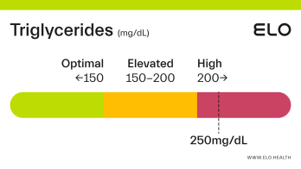
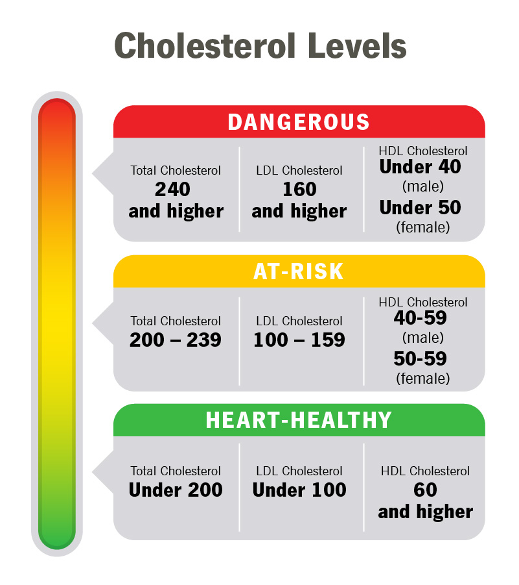

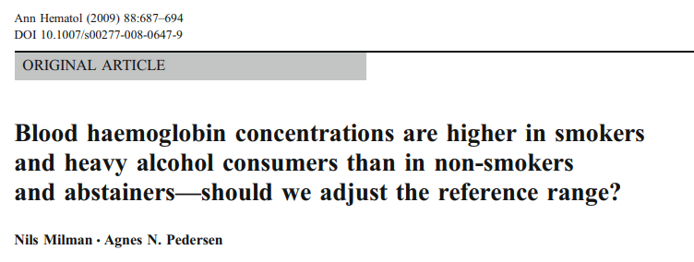
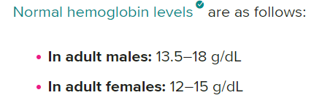
Cholesterol Levels are Averaged Out for Males and Females
Total Cholesterol –
240+ - Dangerous
200-239 -> At Risk
< 200 -> Healthy
LDL
160+ - Dangerous
100 – 159 -> At Risk
< 100 -> Healthy
HDL
< 45 - Dangerous
45 – 60 > At Risk
60+ -> Healthy
Triglycerides Levels
200+ - Dangerous
150-200 -> At Risk
< 150 -> Healthy
Source: https://my.clevelandclinic.org/health/articles/11920-cholesterol-numbers-what-do-they-mean
Source: https://hal.science/hal-00535009/document

Slide 3
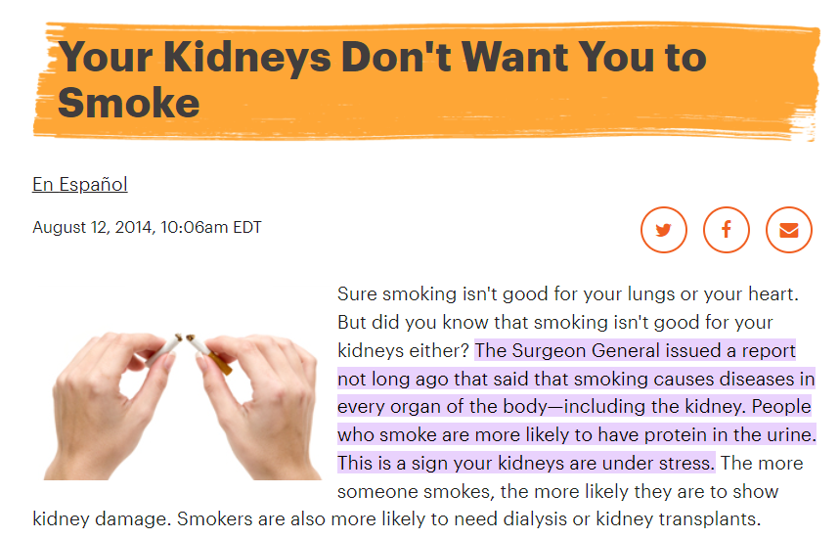
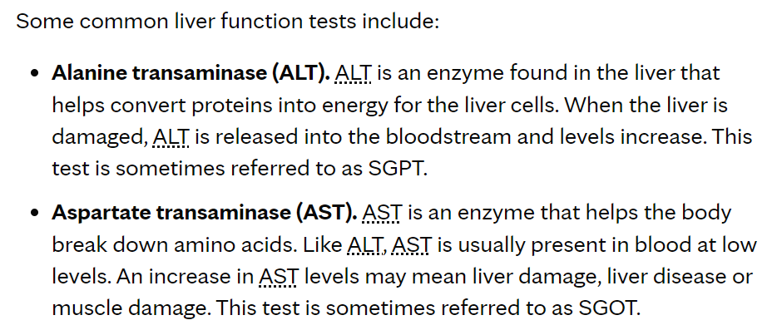
Source: https://www.mayoclinic.org/tests-procedures/liver-function-tests/about/pac-20394595#:~:text=Standard%20range%20blood%20test%20results,8%20to%2048%20U%2FL%20
Source: https://www.kidney.org/news/kidneyCare/winter09/DontSmoke#:~:text=The%20Surgeon%20General%20issued%20a,your%20kidneys%20are%20under%20stress

Slide 4
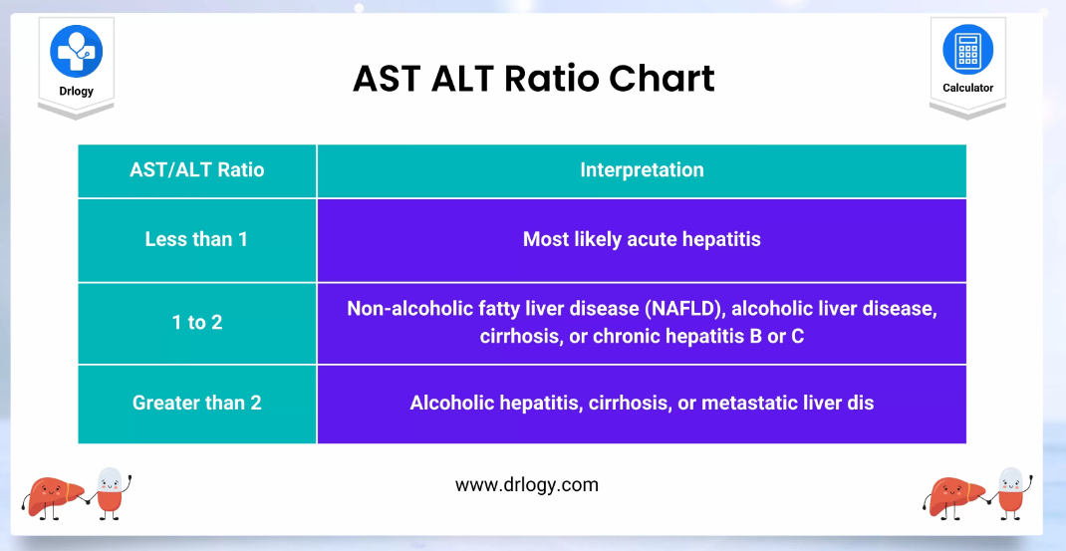
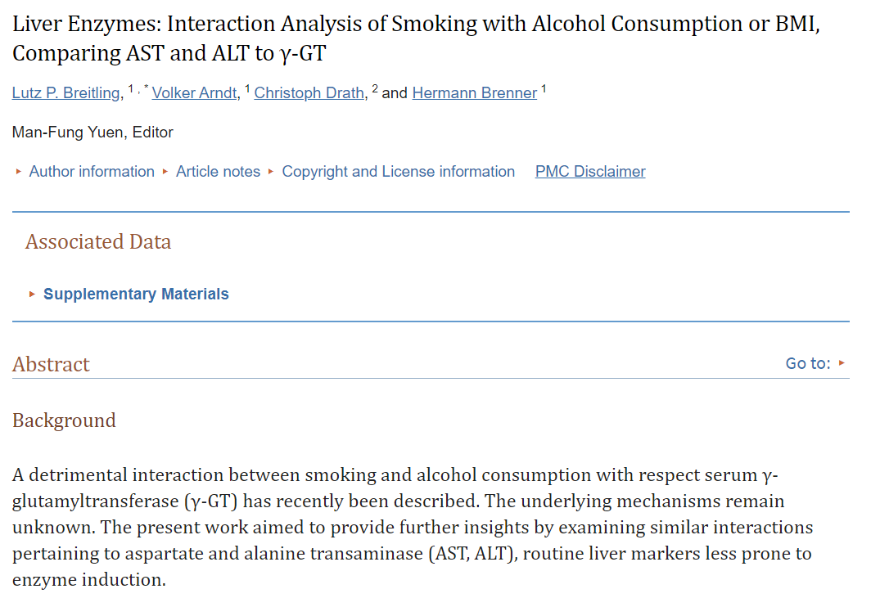
Source: https://drlogy.com/calculator/ast-alt-ratio
Source: https://www.ncbi.nlm.nih.gov/pmc/articles/PMC3222662/

Slide 5
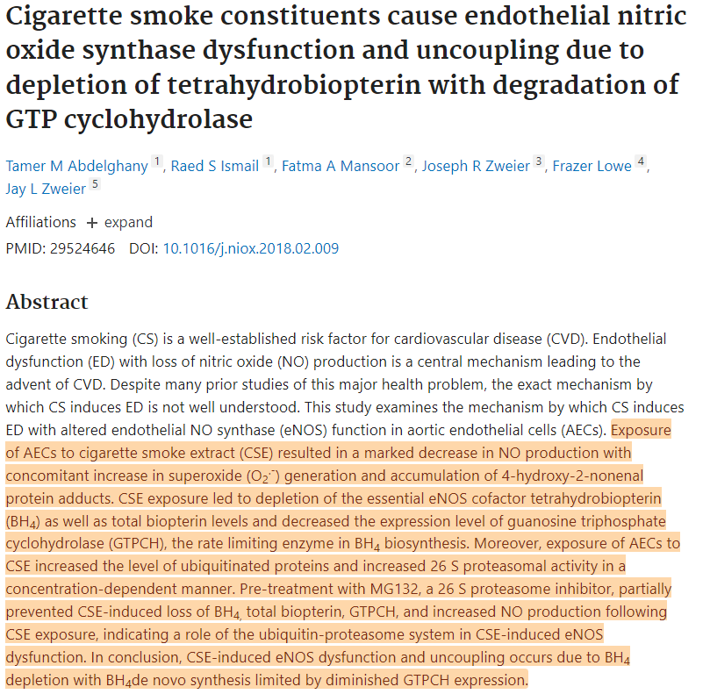
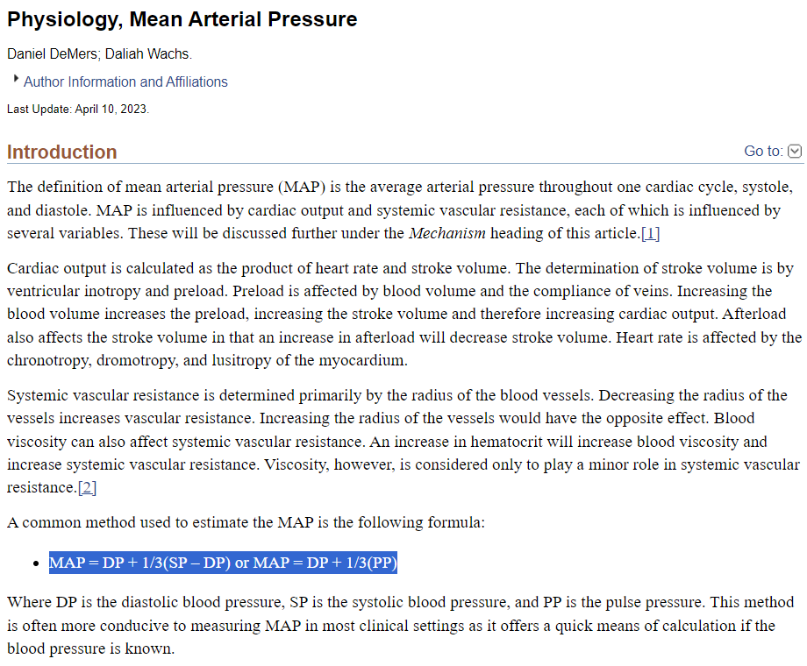
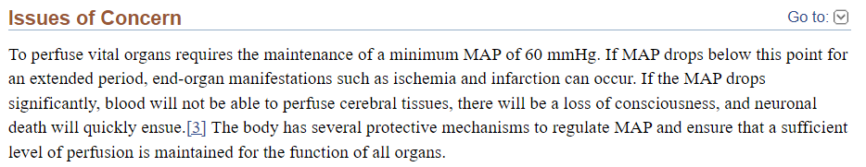
Source: https://pubmed.ncbi.nlm.nih.gov/29524646/
Source: https://www.ncbi.nlm.nih.gov/books/NBK538226/

Slide 6


Output on training Data – Without PCA
Output on training Data – With PCA

Slide 7
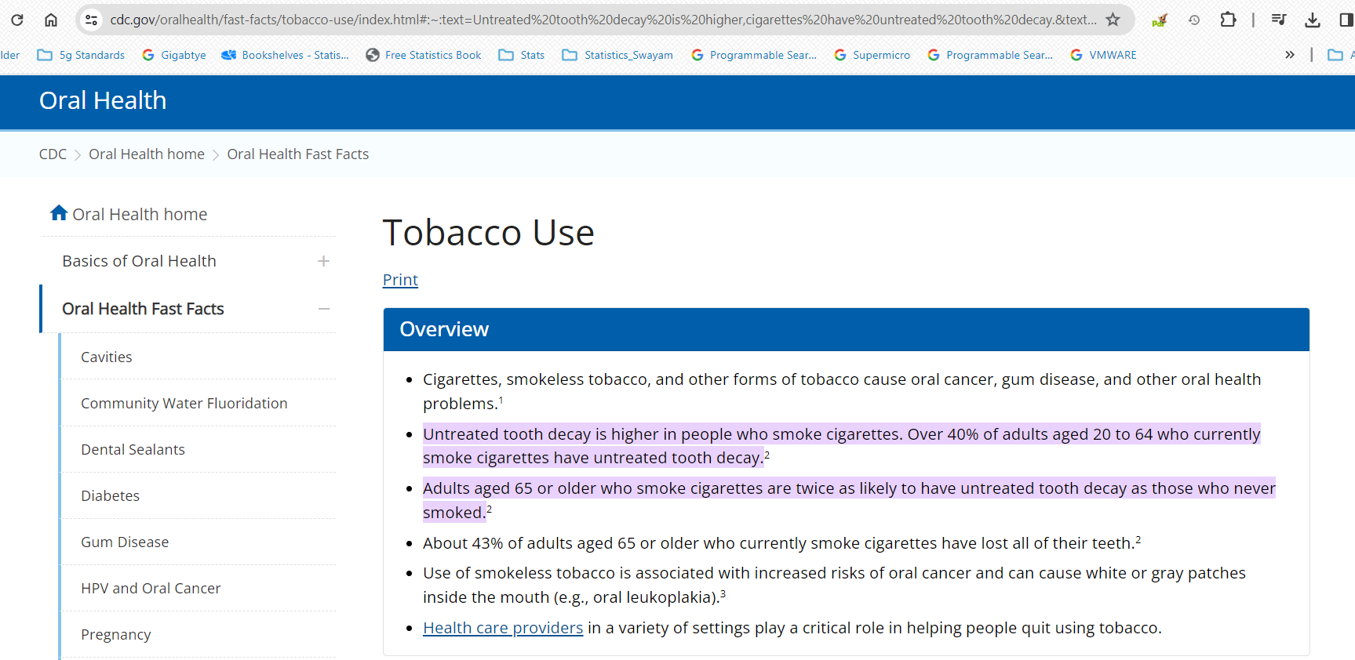

Slide 8
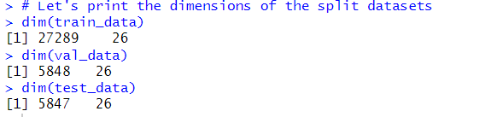

Slide 9
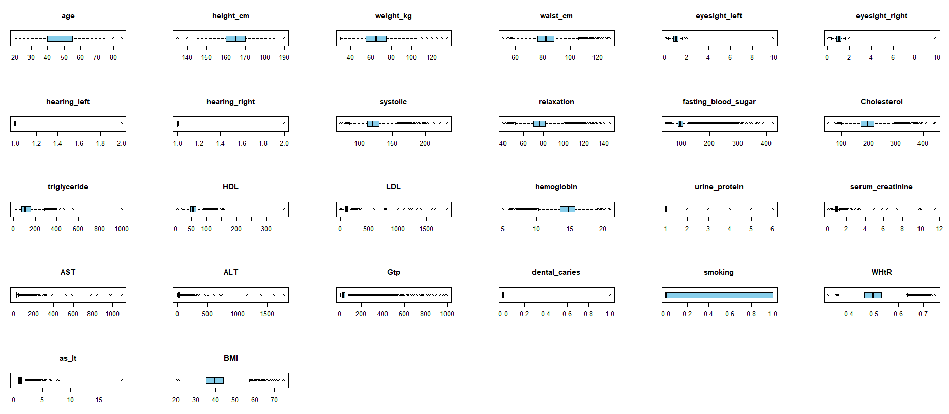

Slide 10
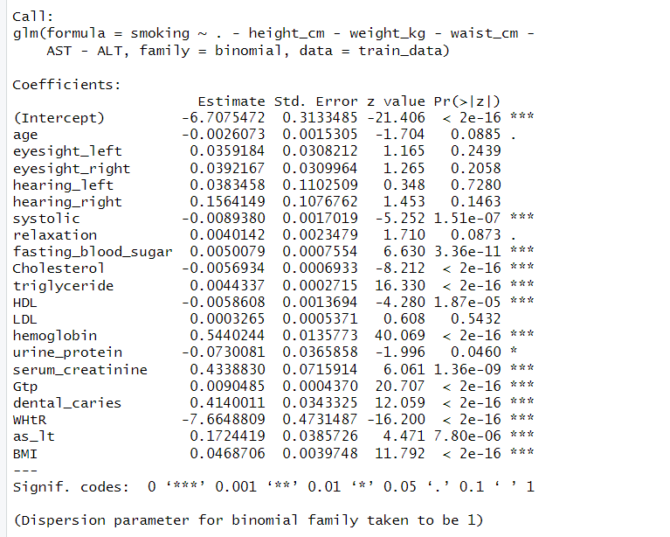

Slide 12
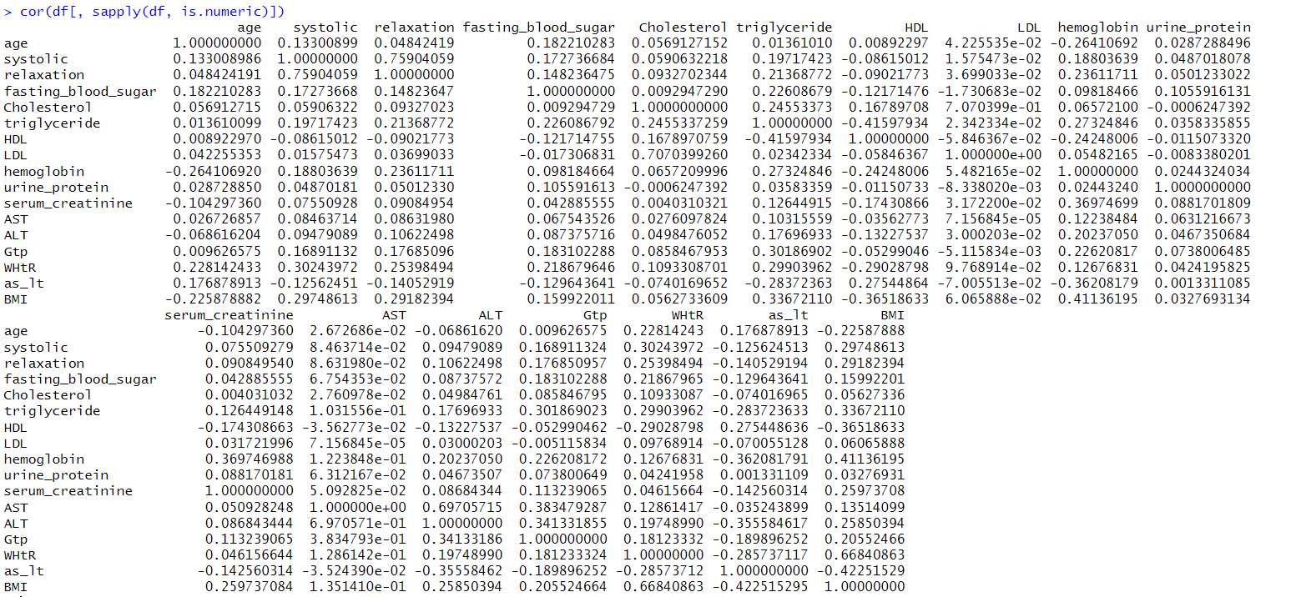




































We are concerned if our variables show correlations (typically > ~40%)
Yellow -> Autocorrelations (Diagonal)
Blue -> >=40% Correlations
Pink -> >=30% Correlations

Slide 13
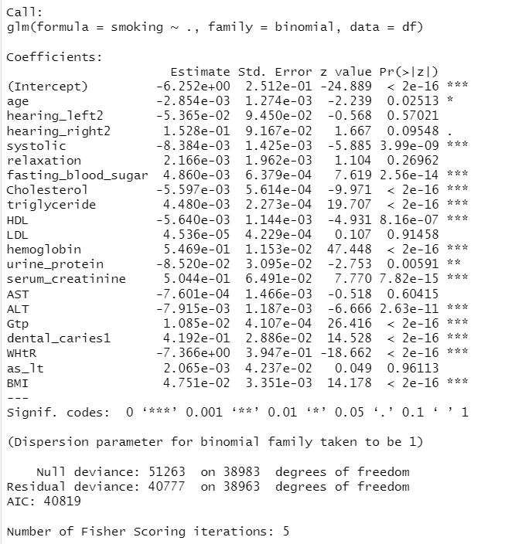

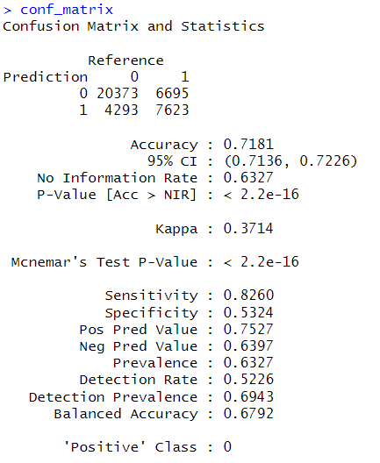
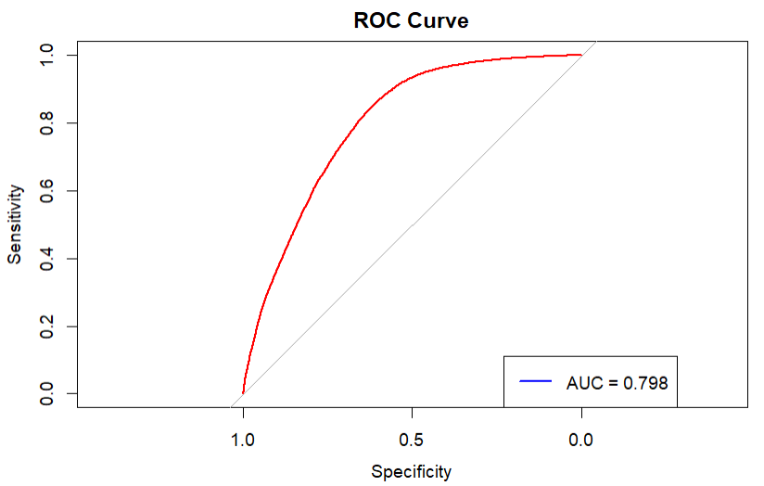









Significant Predictors

Slide 15
Correlated Predictors :
Relaxation <> Systolic ~ 76%
LDL <> Cholesterol ~ 71%
HDL <> triglyceride ~ (42%)
ALT <> AST ~ 70%
BMI <> hemoglobin ~ 41%
BMI <> WHtR ~ 67%
BMI <> as_lt ~ (42%)
Prospective Solution(s)
So, Try Using Interaction Terms
Calculating Mean Arterial Pressure (using Systolic and Relaxation Pressure, so it reduces 2 variables to 1)
1. Try Using Interaction Terms
2. Drop One less relevant predictor using PCA or VIF
In general HDL is Inversely related to triglyceride, so let’s include Interaction Effects for them
Use ASL : ALT, which reduces 1 variable in predictor and also a effective parameter for health parameters. Further, ASL : ALT is not effectively correlated with other parameters.
BMI is correlated with 3 different parameters, hemoglobin, WHtR and AST_ALT ratio
Further, we have WHtR parameter which is an alternative to BMI and is also highly correlated with BMI (67%)
So, we drop BMI as predictor, and use WHtR only, which reduces collinearity and also includes the effect of BMI through WHtR.

Slide 16
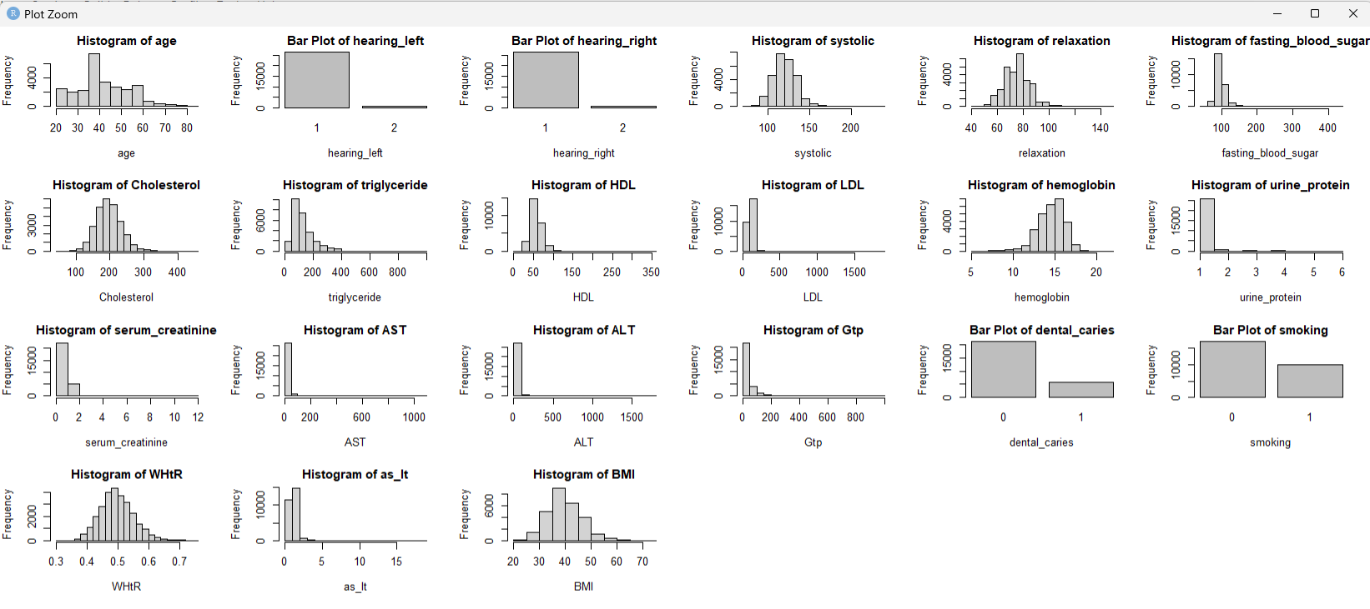
Almost Normally Distributed

Slide 17
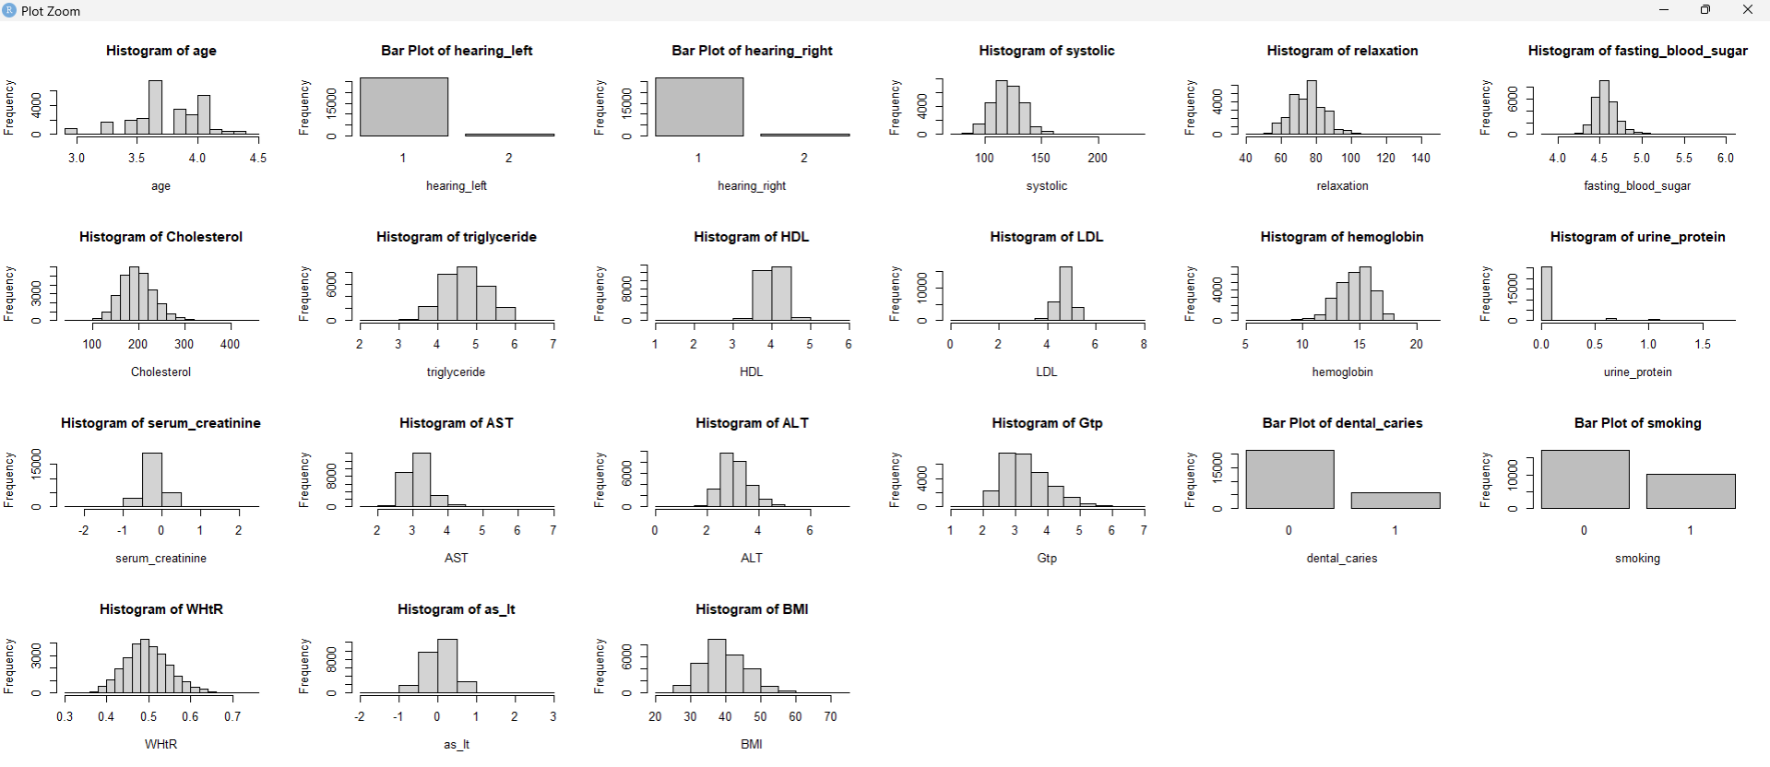
Almost Normally Distributed (Original)
Somewhat Normal (After Log Transformation)
Still Skewed

Slide 18
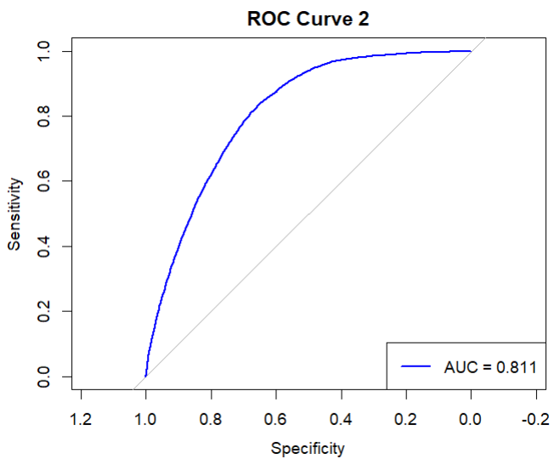
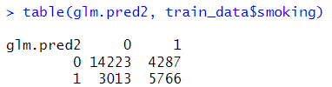
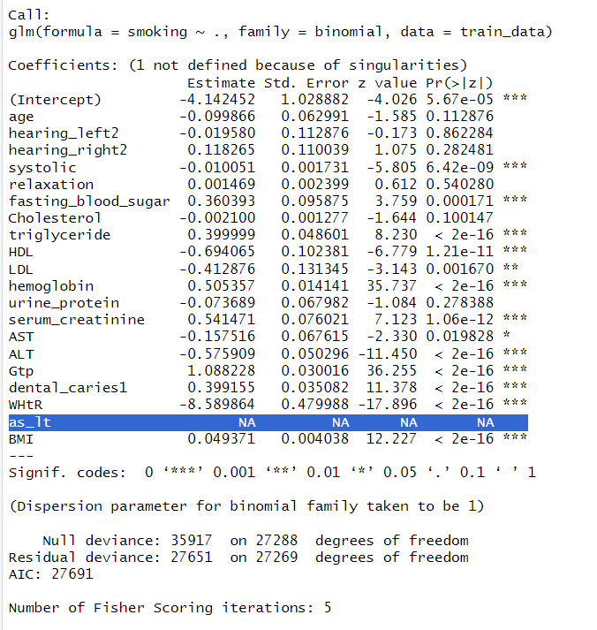
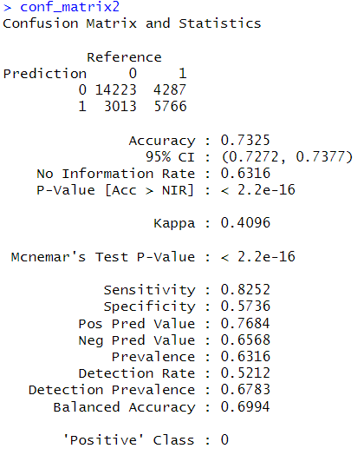


Slide 20
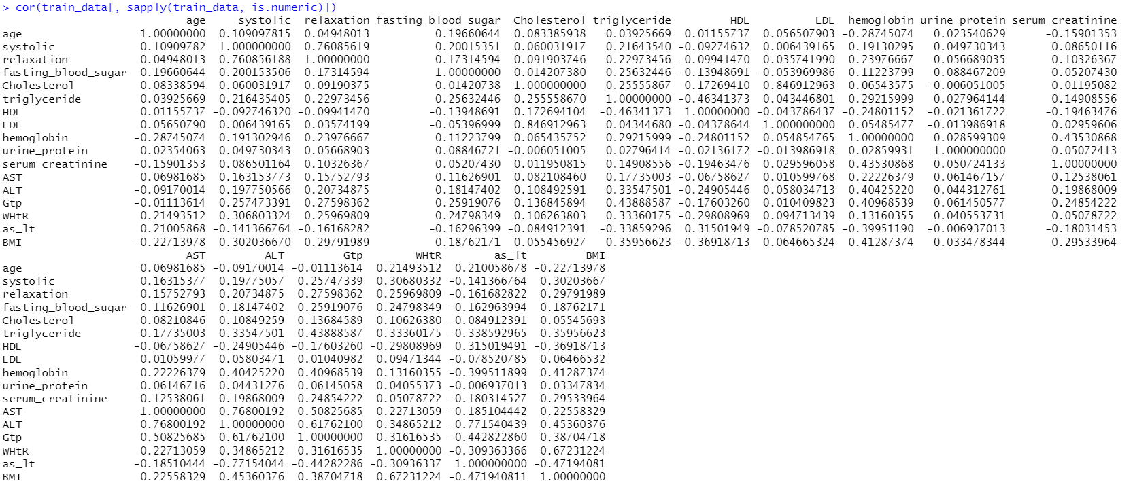










































Slide 21
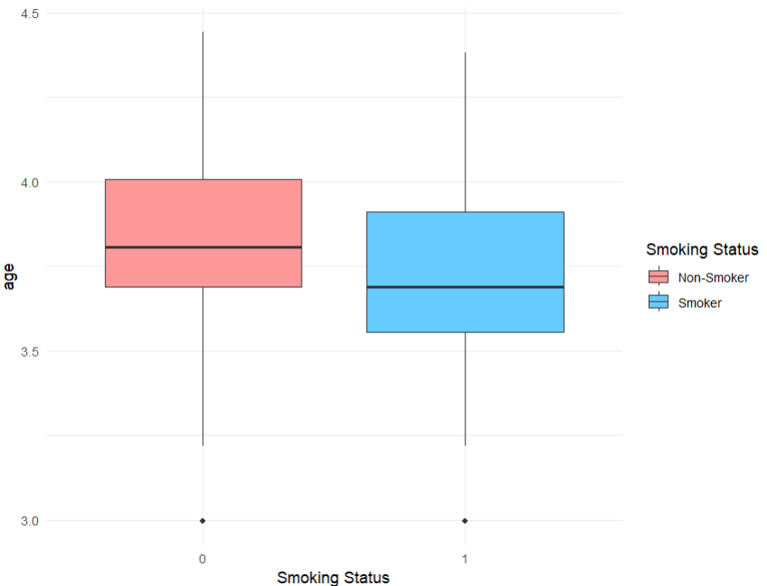
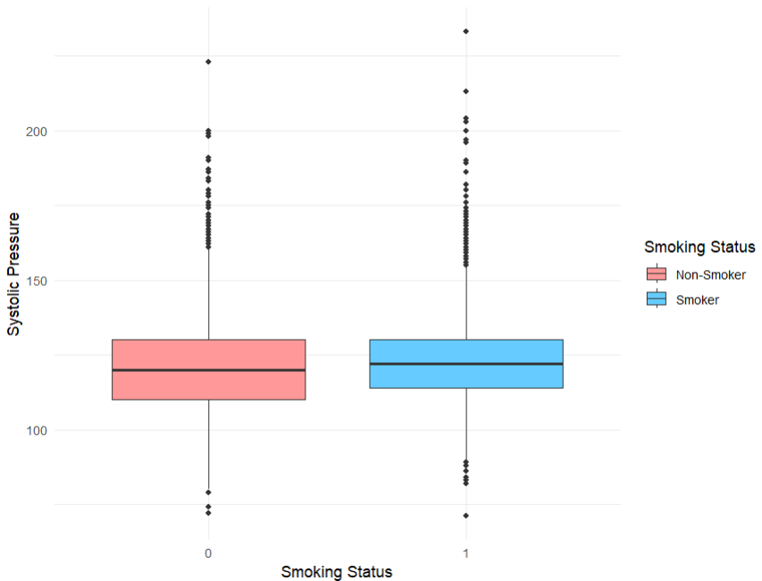
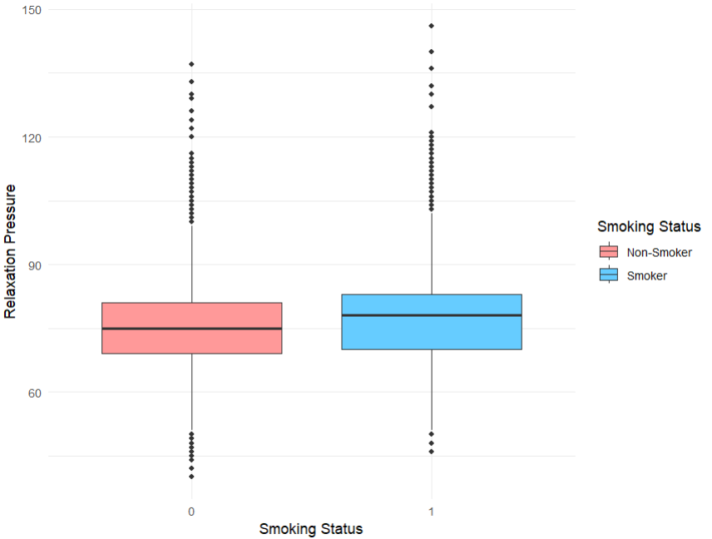
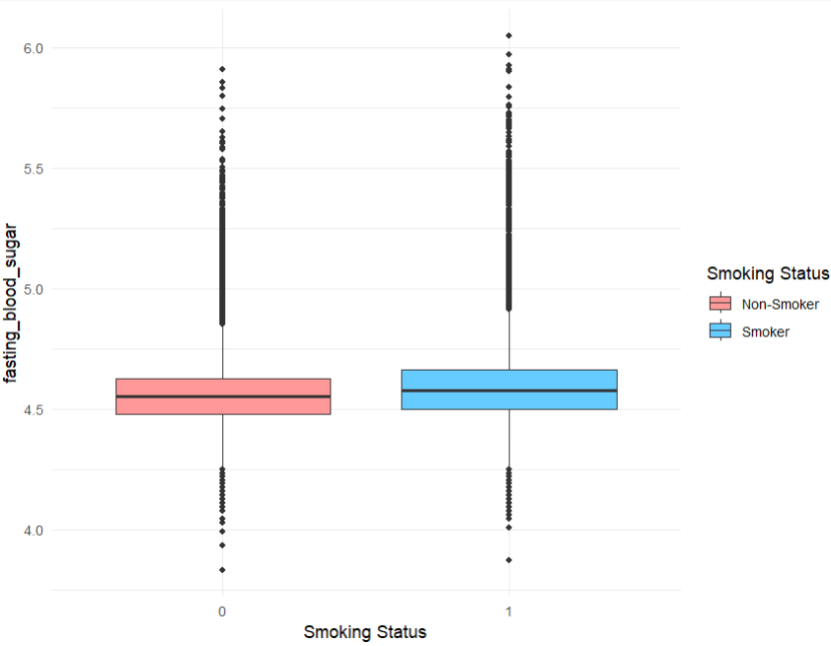
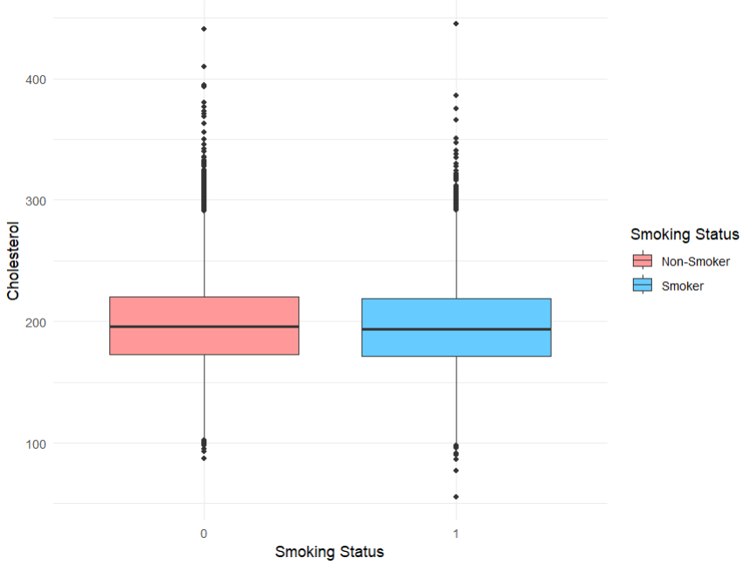
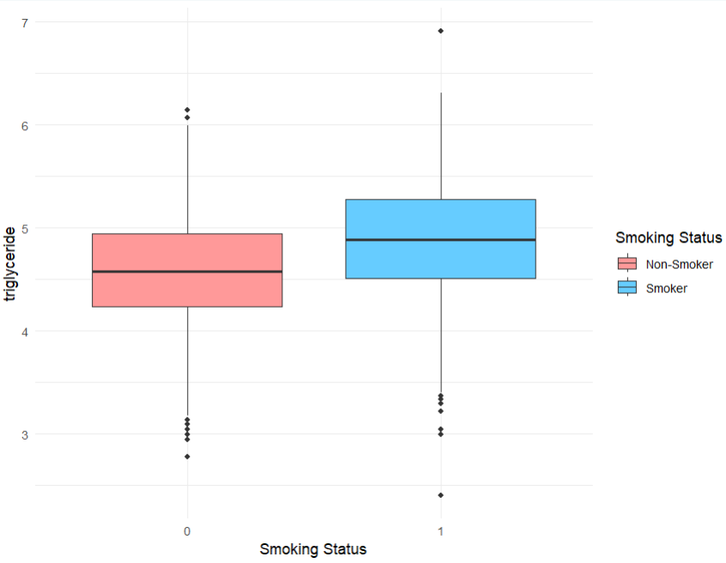
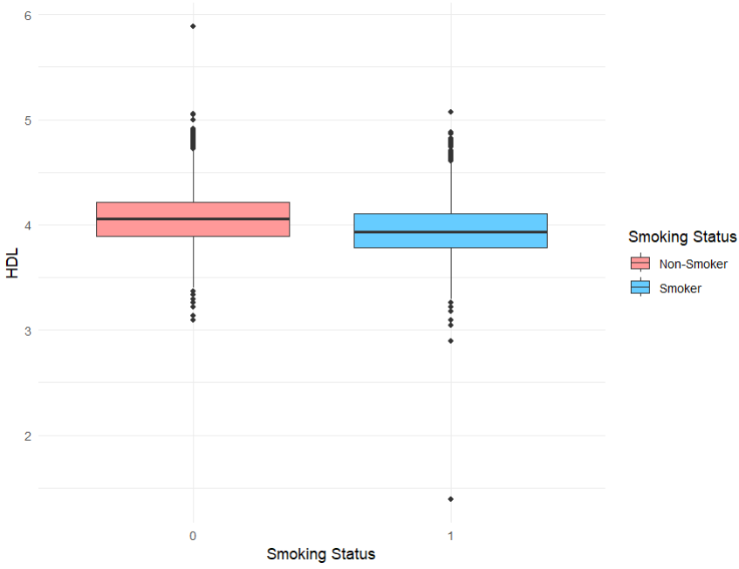
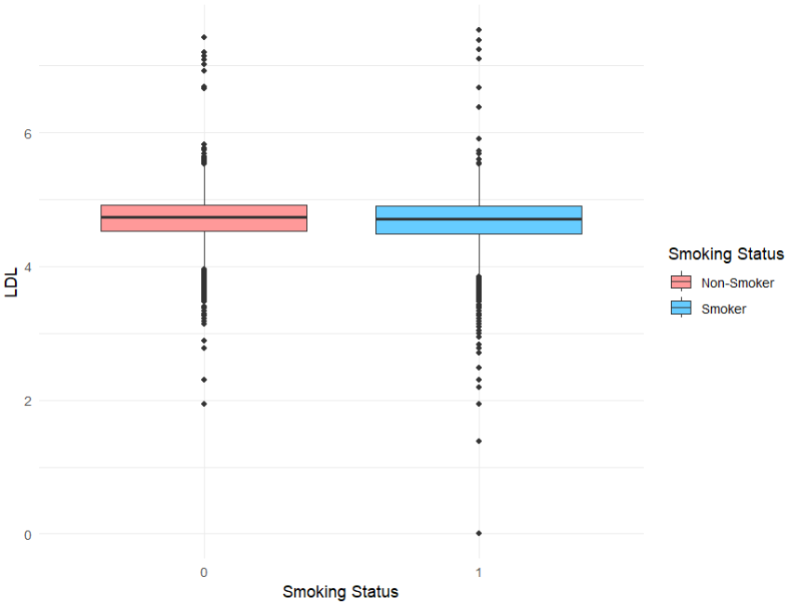
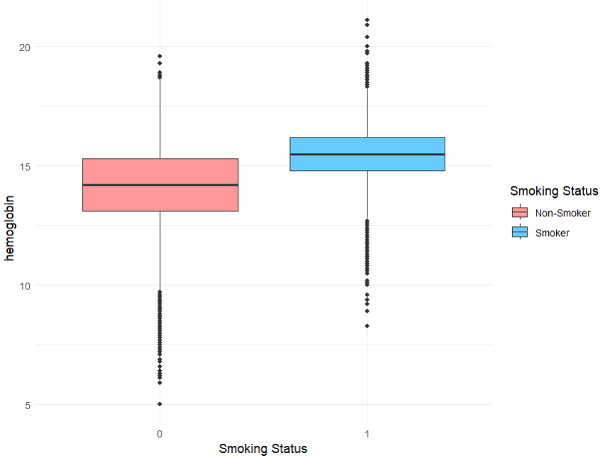
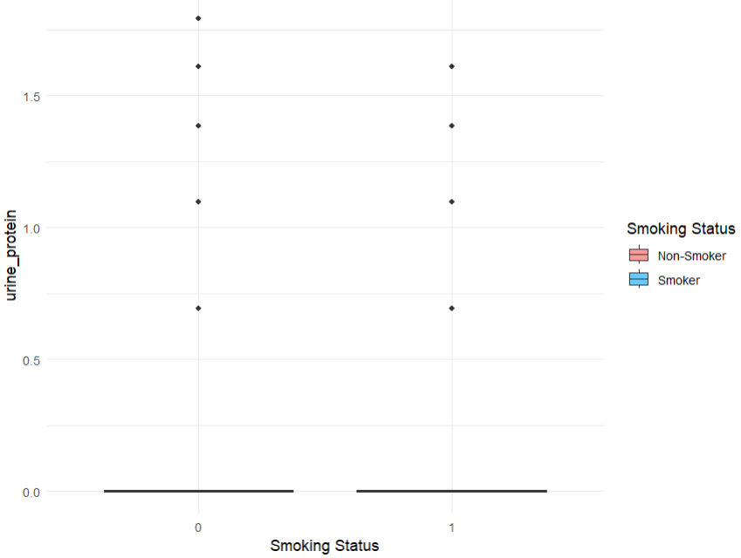
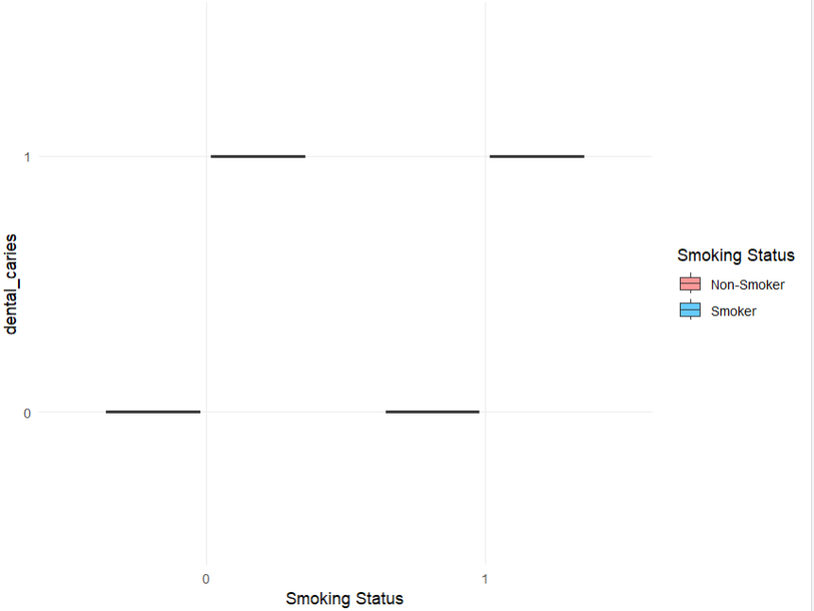
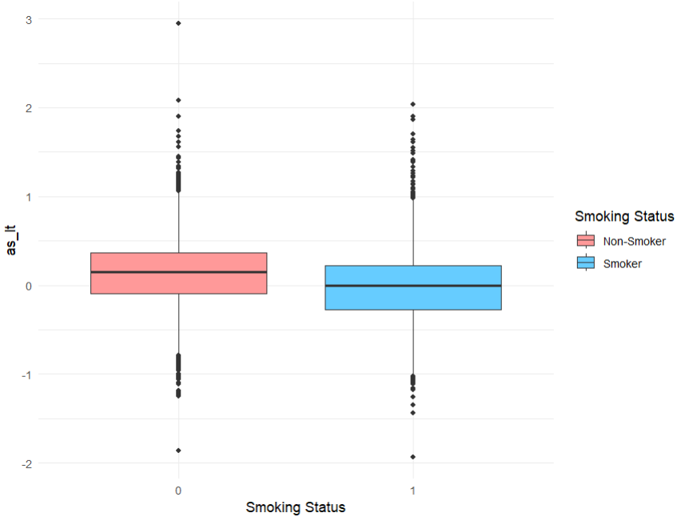
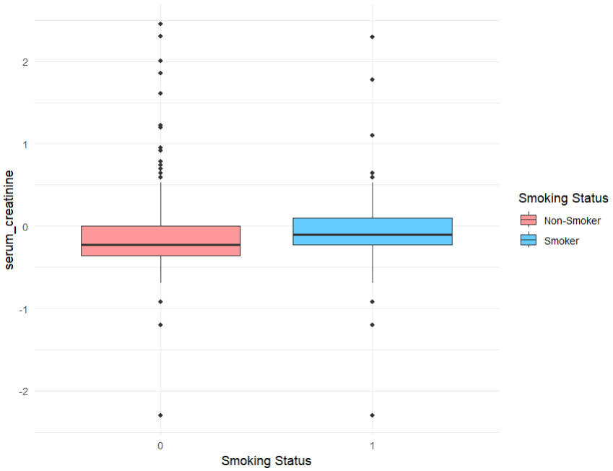
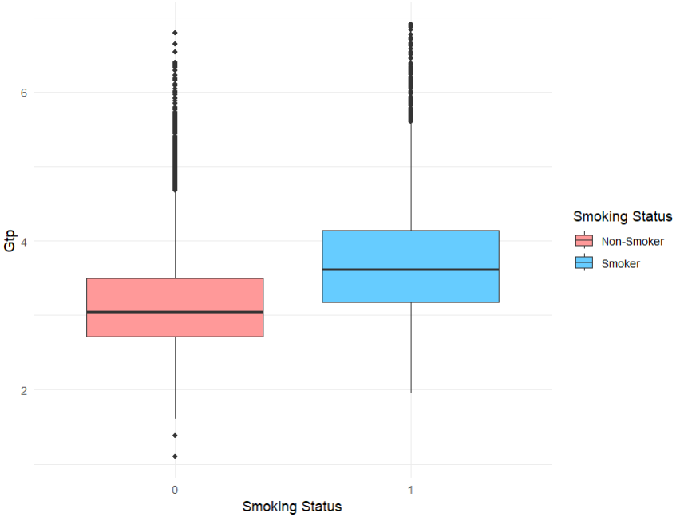
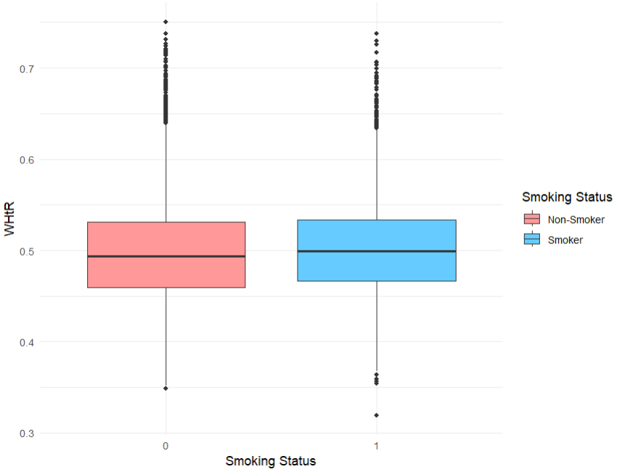

Slide 22
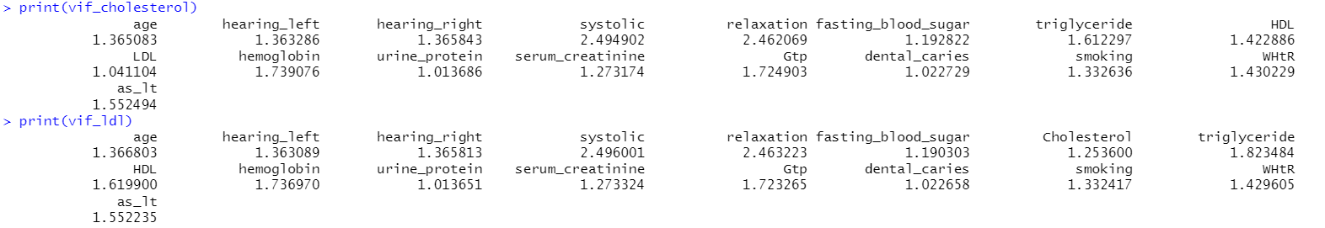
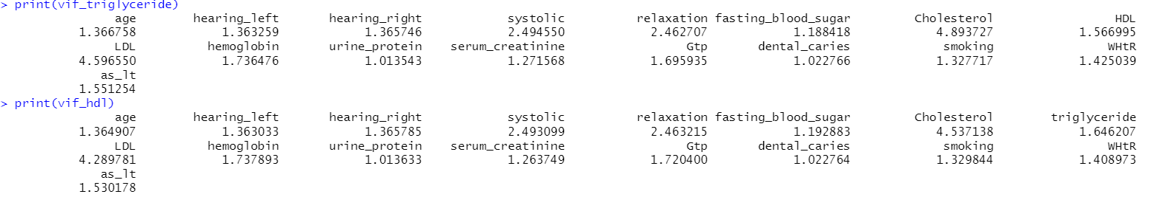
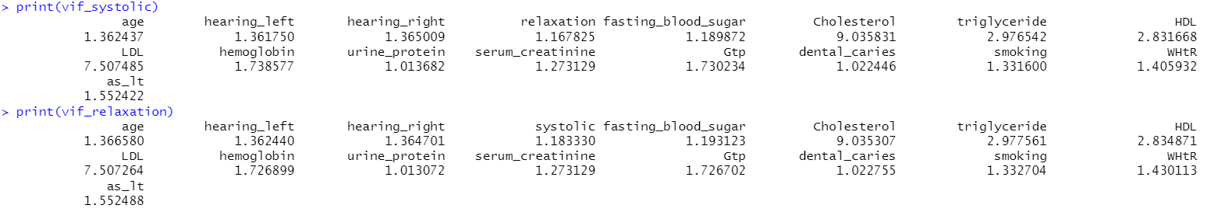
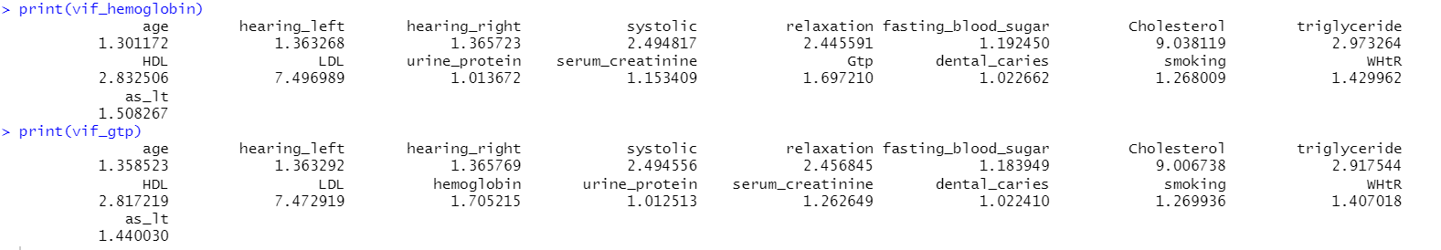

Slide 23

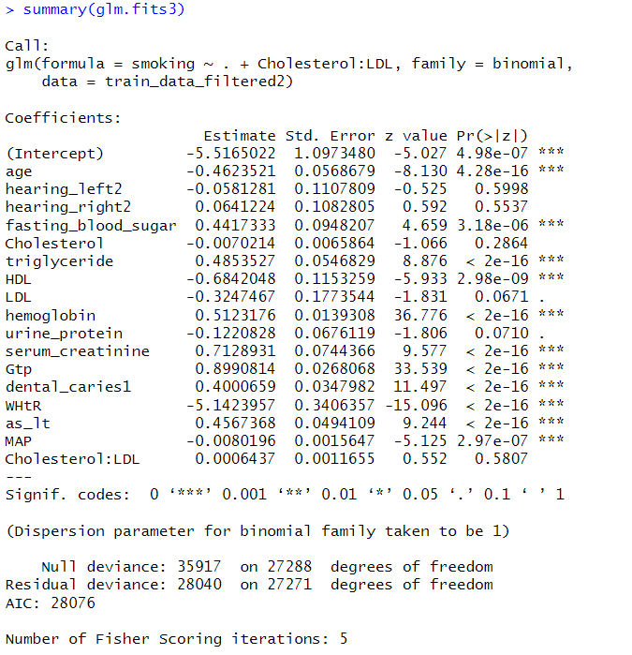
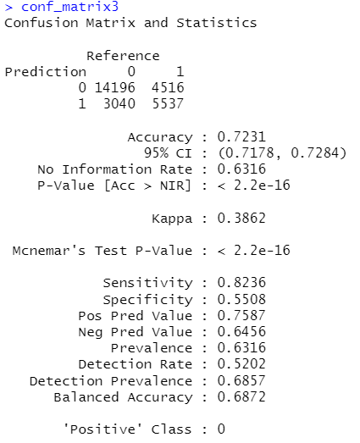
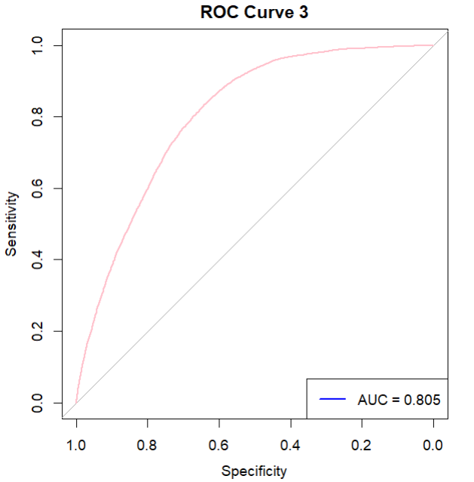













Slide 24
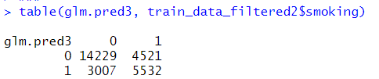
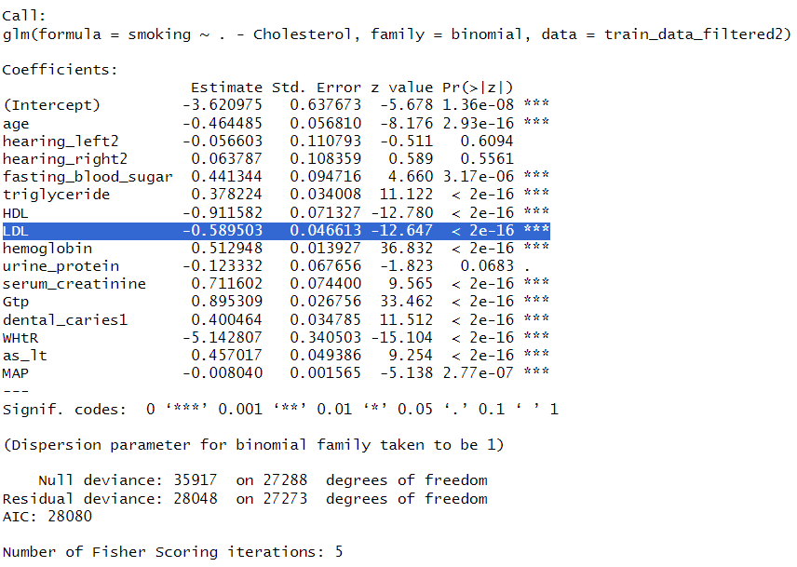











Slide 25













Slide 26
















Slide 27













Slide 28





Slide 29












Slide 30






Slide 32
Correlated Predictors :
Relaxation <> Systolic ~ 76%
LDL <> Cholesterol ~ 71%
HDL <> triglyceride ~ (42%)
ALT <> AST ~ 70%
BMI <> hemoglobin ~ 41%
BMI <> WHtR ~ 67%
BMI <> as_lt ~ (42%)
Prospective Solution(s)
So, Try Using Interaction Terms
Calculating Mean Arterial Pressure (using Systolic and Relaxation Pressure, so it reduces 2 variables to 1)
1. Try Using Interaction Terms
2. Drop One less relevant predictor using PCA or VIF
In general HDL is Inversely related to triglyceride, so let’s include Interaction Effects for them
Use ASL : ALT, which reduces 1 variable in predictor and also a effective parameter for health parameters. Further, ASL : ALT is not effectively correlated with other parameters.
BMI is correlated with 3 different parameters, hemoglobin, WHtR and AST_ALT ratio
Further, we have WHtR parameter which is an alternative to BMI and is also highly correlated with BMI (67%)
So, we drop BMI as predictor, and use WHtR only, which reduces collinearity and also includes the effect of BMI through WHtR.

Slide 33
Correlated Predictors :
Relaxation <> Systolic ~ 76%
LDL <> Cholesterol ~ 85%
HDL <> triglyceride ~ (46%)
Gtp <> triglyceride ~ 44%
Serum_creatinine <> Hb ~(44%)
ALT <> Hb ~ 40%
Gtp <> Hb ~ 41%
ALT <> AST ~ 77%
Gtp <> AST ~ 51%
Gtp <> ALT ~ 62%
as_lt <> ALT ~(77%)
as_lt <> Gtp ~(44%)
BMI <> ALT ~ 45%
BMI <> Hb ~ 41%
BMI <> WHtR ~ 67%
BMI <> as_lt ~ (42%)

